Slide 1
Bragg’s CONDITION
This law gives the angles for coherent and incoherent scattering from a crystal lattice.
Bragg diffraction occurs when radiation, with a wavelength comparable to atomic spacings, is scattered by the atoms of a crystalline system, and undergoes constructive interference.
When the scattered waves interfere constructively, they remain in phase since the difference between the path lengths of the two waves is equal to an integer multiple of the wavelength
The path difference between two waves undergoing interference is given by 2d sin θ, where θ is the glancing angle

Slide 2
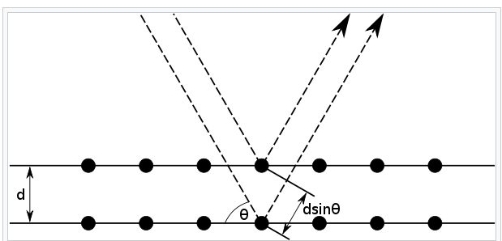
See here θ is not measured from normal.
2d sin θ = n λ (This is bragg’s condition , λ = wavelength of light)

Slide 3
Why do we need to understand wave properties of light ?
Our project concept is biomimicking to chameleon colour changing property
In chameleons they have two superimposed layers within their skin that control their colour and thermoregulation. The top layer contains a lattice of guanine nanocrystals, and by exciting this lattice the spacing between the nanocrystals can be manipulated, which in turn affects which wavelengths of light are reflected and which are absorbed.
Exciting the lattice increases the distance between the nanocrystals, and the skin reflects longer wavelengths of light.
Thus, in a relaxed state the crystals reflect blue and green, but in an excited state the longer wavelengths such as yellow, orange, green, and red are reflected.

Slide 4
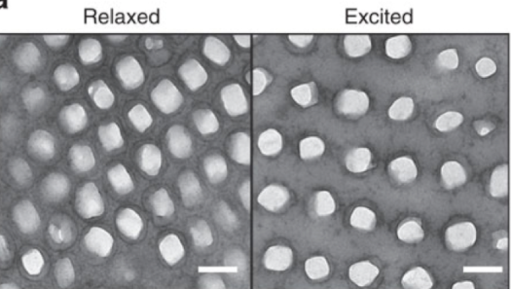
Nanocrystal under chameleon skin
Chameleon skin contains different types of chromatophore (color-bearing) cells organized in layers within the skin.
The upper layer of skin contains cells with yellow and red pigments, while lower layers contain cells with dark melanin pigment, which appears black or brown.
The skin of a chameleon also contains some yellow pigments, which combined with the blue reflected by a relaxed crystal lattice results in the characteristic green colour which is common of many chameleons in their relaxed state.
Just below the layer of yellow and red chromatophores is a layer of cells called iridophores .

Slide 5
Rather than containing pigment, iridophores contain an organized array of transparent, nano-sized crystals that reflect specific wavelengths of light. The reflected light is perceived as color.
Iridophores, sometimes also called guanophores, are kind of pigment cells that reflect light using plates of crystalline chemochromes made from guanine. When illuminated they generate iridescent colours because of the diffraction of light within the stacked plates.
So, The crystal structures and pigments in chameleon skin both contribute to the overall color of the skin.
We can say iridophores change the way we perceive chromatophore’s.

Slide 6
References:
en.wikipedia.org https://en.wikipedia.org/wiki/Chromatophore#Background_adaptation https://en.wikipedia.org/wiki/Chameleon#Mechanism_of_colour_change https://en.wikipedia.org/wiki/Diffraction
Asknature.org https://asknature.org/strategy/skin-changes-color-2/#:~:text=The%20latest%20research%20on%20color,overall%20color%20of%20the%20skin
Youtube: https://youtu.be/OfxApSZ5bCM
olympus-lifescience.com https://www.olympus-lifescience.com/en/microscope-resource/primer/lightandcolor/interference

Slide 7
How to use this properties and what may be challenges ?
To get all colours and intensities .
To mimic nanostructure pattern .

